Slide 1


Toxic Environmental Risks Analytical Intelligence

Slide 2

Downloading The Data You Want II
Toxic Environmental Risks Analytical Intelligence

Slide 3
01
02
03
Learning objective
Assignment
Part 1 of the assignment
Slide 4
Slide 5
Slides 6-7
04
05
Discussion, feedback and final assessment
Part 2 of the assignment
Slides 8-9
Slides 10-13

Slide 4





How to filter the search engine at TERAIN Premium, so that the format of the data export document matches the demands of the task at hand
Learning objective
www.terain.org

Slide 5

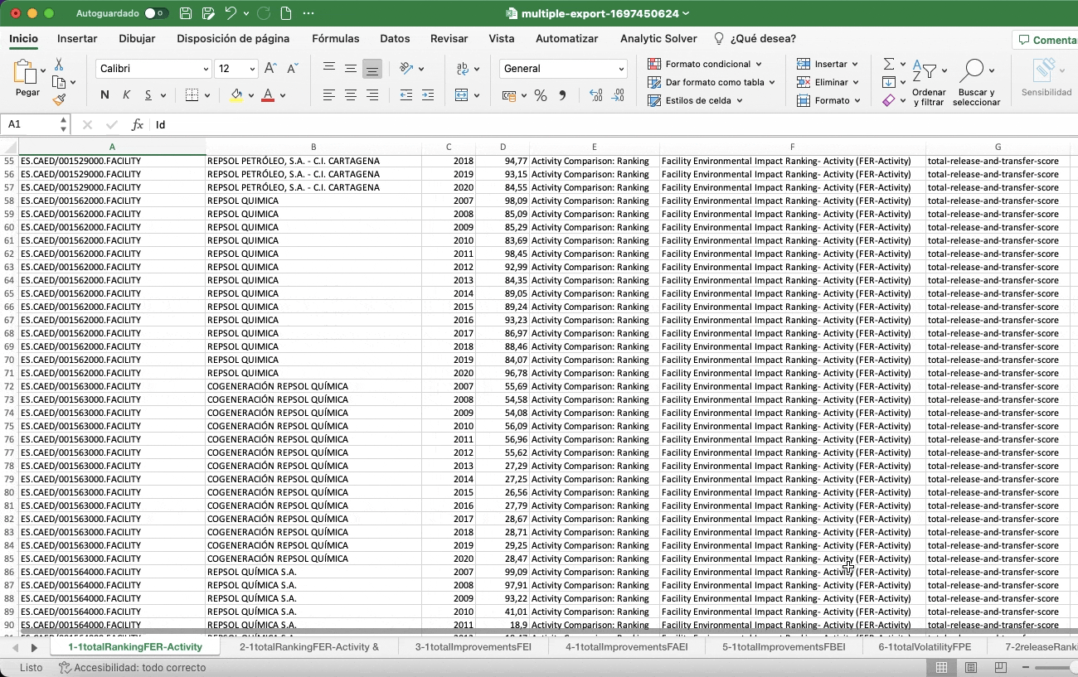



Assignment
Think about the format of the Excel document for data exports
Think which format is a better match for the task at hand and adapt your search queries
www.terain.org

Slide 6

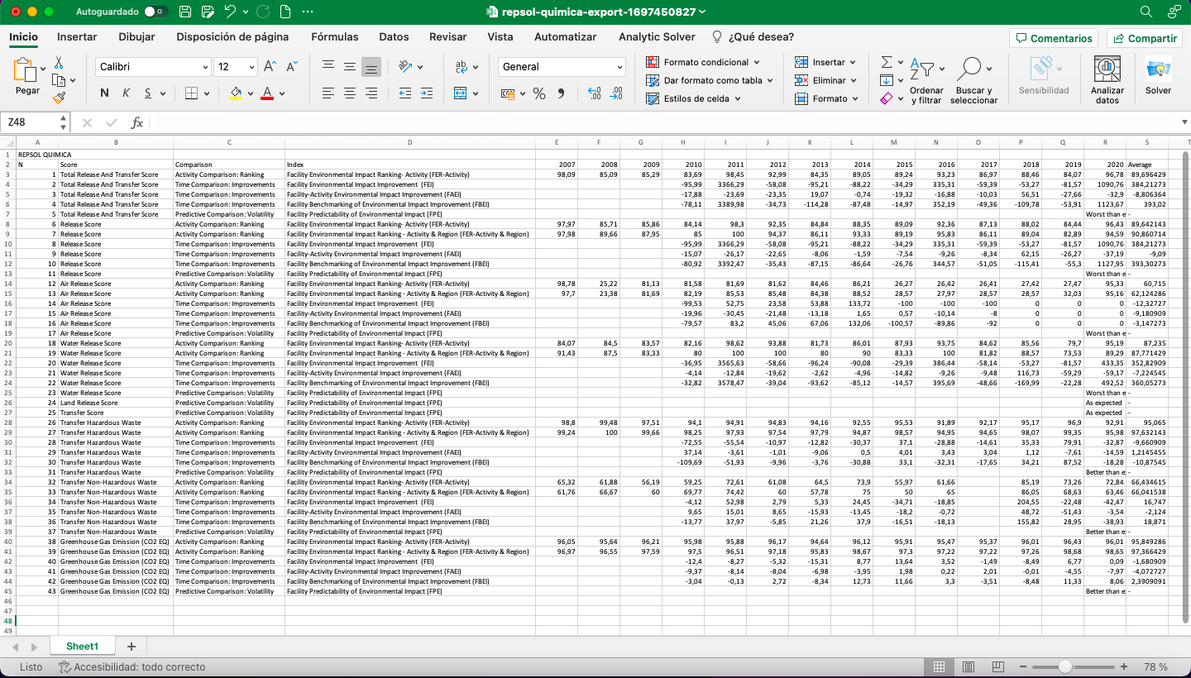

Data download format at TERAIN
www.terain.org

Slide 7

This is what an export of multiple data items looks like
One sheet per index
The scores of all the selected items aggregated by index
Large quantities of sheets in one document depending on the nº of scores and types of comparisons selected
www.terain.org

Slide 8
This is what an export of a single item looks like
One sheet with all the data in the form of a chart
The structure of the search engine is reflected (Score >Type of comparison > Index)
www.terain.org

Slide 9
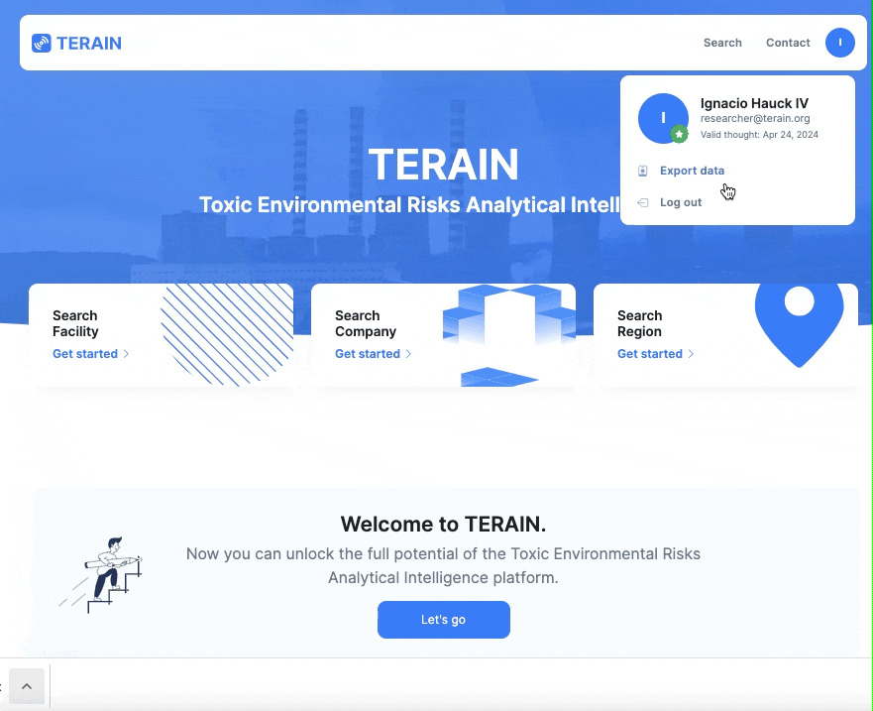



Adapt your search queries
www.terain.org

Slide 10
While the main search engine that is activated when clicking on any of the three categories of the home page only allows single data export, the advanced search engine allows both.
The differences between multiple and single data exports provide formats tailored to your needs.
www.terain.org

Slide 11

Class discussion and feedback
www.terain.org

Slide 12



Class discussion:
At the multiple data export search engine for facilities, you are going to select the three types of comparisons and the Total Release and Transfer Score. Then, you are going to select all five facilities at REPSOL PETROLEO, S.A., and download their data. Now, make a quick analisis on how their results have evolved throughout time.
www.terain.org

Slide 13
Class discussion:
Changing the settings to the search by company, you are going to select all the environmental impact scores, as well as all types of comparisons, and download the data for REPSOL PETROLEO, S.A. and REPSOL QUIMICA, S.A., in two individual exports. Make a quick analysis on how their results have evolved throughout time.
www.terain.org

Slide 14
Class discussion:
Think about at least two different situations that would better benefit of each type of data export and why.
www.terain.org

Slide 15






Feedback:
Was the assignment clear, useful and effective in helping you use the platform?
What do you think helped you the most?
Is there anything you would change about the assignment or the platform?
Contact us
www.terain.org

Slide 16


Toxic Environmental Risks Analytical Intelligence
Grant PDC2021-120953-I00 funded by MCIN/AEI/10.13039/501100011033

