Slide 1


Toxic Environmental Risks Analytical Intelligence

Slide 2

Downloading The Data You Want
Toxic Environmental Risks Analytical Intelligence

Slide 3
01
02
03
Learning objective
Assignment
Part 1 of the assignment
Slide 4
Slide 5
Slides 6-7
04
05
Discussion, feedback and final assessment
Part 2 of the assignment
Slides 8-9
Slides 10-13

Slide 4





Learning objective
How to refine search queries to download data from TERAIN Premium and work with it
www.terain.org

Slide 5

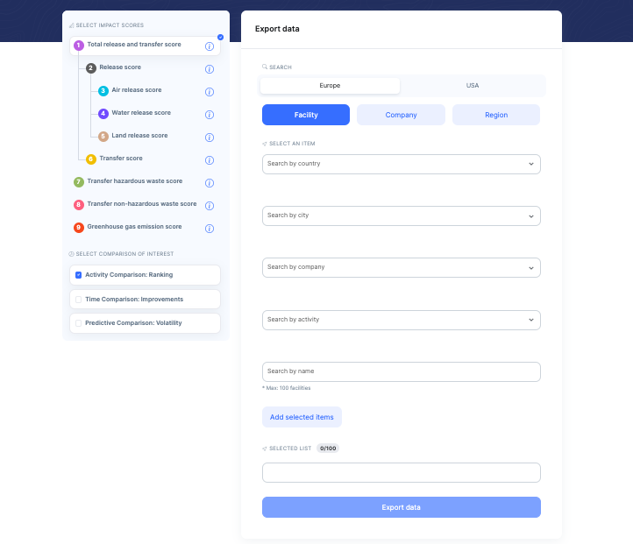



Assignment
Familirize yourself with the search engine for data export
Refine your search queries to download large batches of specific data
www.terain.org

Slide 6


Familiarize yourself with TERAIN
www.terain.org

Slide 7
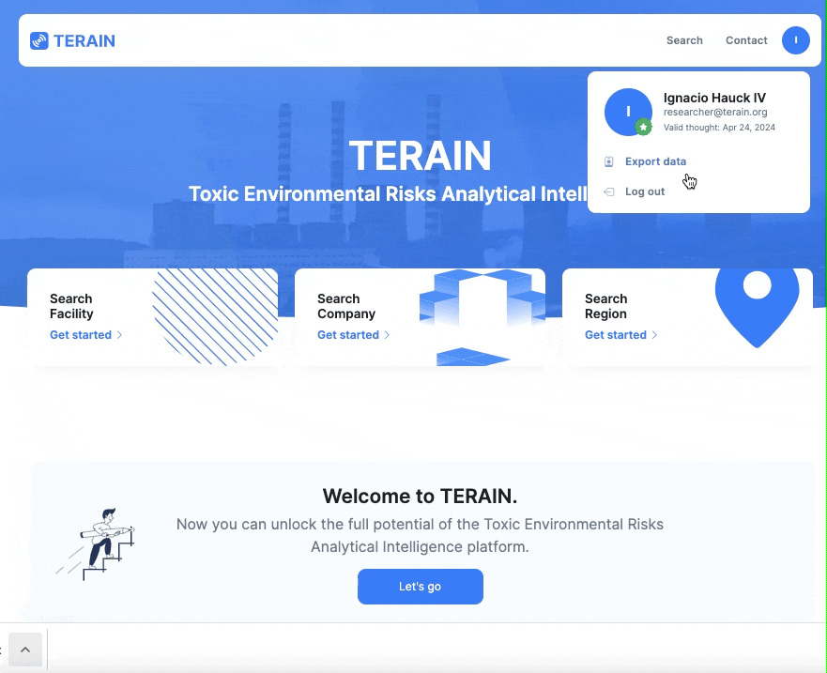
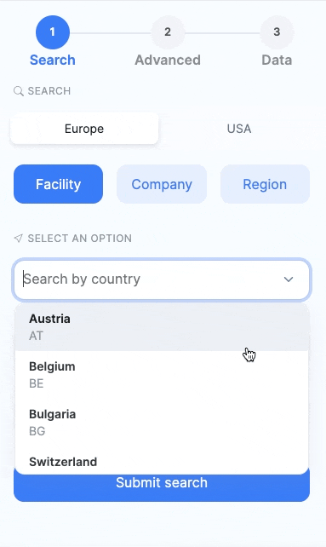
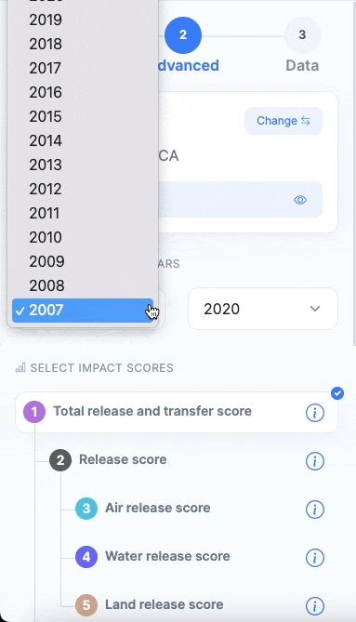

How does the data export search engine work?
Allows you to download data directly to your computer in the form of a spreadsheet
A combination of steps 1 and 2 of the search engine in the free version
Main differences with the free search engine:
Extra drop-down menus for a more precise query refinement
The possibility of downloading data for many different search items at a time
The possibility of selecting all the facilities of a company
www.terain.org

Slide 8



Refine your search queries
www.terain.org

Slide 9
The search engine for data export allows you to automatically select all the facilities, companies, or regions that are part of the same country, industrial activity, or even the same company when it comes to facilities.
To avoid missing any item when the number of results is higher than the limit for each category, you need to refine your search query.
www.terain.org

Slide 10

Class discussion and feedback
www.terain.org

Slide 11



Class discussion:
If you wanted to download the data of a specific industrial activity in the whole EU that has more results than what the platform allows you to download at once, how would you refine your query settings?
www.terain.org

Slide 12
Class discussion:
Why do you think the categorizations by activity are different depending on whether you set the query to Europe or the USA?
What purposes do you think the downloaded data can serve? Give at least three examples.
www.terain.org

Slide 13






Feedback:
Was the assignment clear, useful and effective in helping you use the platform?
What do you think helped you the most?
Is there anything you would change about the assignment or the platform?
Contact us
www.terain.org

Slide 14


Toxic Environmental Risks Analytical Intelligence
Grant PDC2021-120953-I00 funded by MCIN/AEI/10.13039/501100011033

